Slide 1
Stock Price Prediction
Presented by
Mufaddal Naya 17BIT055
Guided by
Dr. Ankit Thakkar

Slide 2
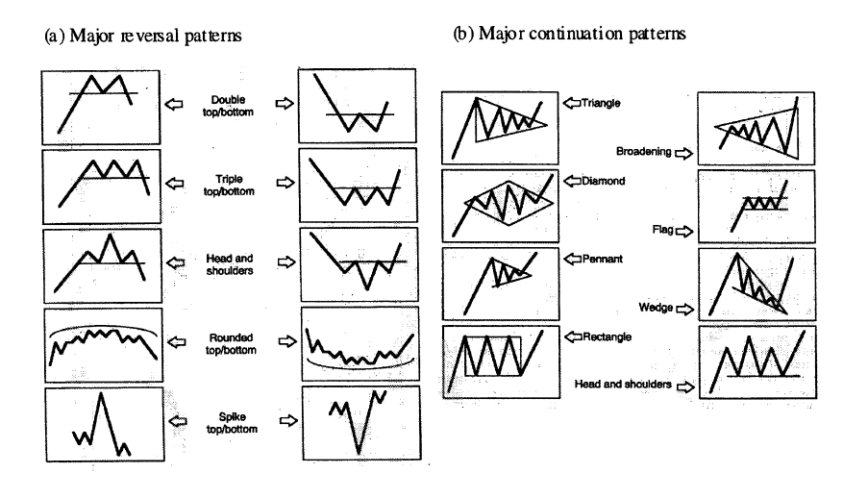
Introduction
Time Series VS Cross Sectional Data
Stock price prediction attracts researcher across the globe
The random change in the stock price of a company is referred as random-walk behavior of stock prices with time.
Various linear and non-linear models are being used to predict the Future prices of a given company.
Notes:
Stock market analysis and prediction will reveal the market patterns and predict the time to purchase stock. The successful prediction of a stock's future price could yield significant profit. This is done using large historic market data to represent varying conditions and confirming that the time series patterns have statistically significant predictive power for high probability of profitable trades and high profitable returns for the competitive business investment.
But since stock market return is noisy, uncertain, chaotic and nonlinear in nature
However, stock forecasting is still severely limited due to its non-stationary, seasonal and in general unpredictable nature

Slide 3
Motivation For this topic
Notes:
you buy a part of the company
Company can collect money
Buy low and sell high
Stock Market prediction and analysis is the act of trying to determine the future value of a company stock or other financial instrument traded on an exchange. Stock market is the important part of economy of the country and plays a vital role in the growth of the industry and commerce of the country that eventually affects the economy of the country. Both investors and industry are involved in stock market and wants to know whether some stock will rise or fall over certain period of time. The stock market is the primary source for any company to raise funds for business expansions. It is based on the concept of demand and supply

Slide 4
What Impacts the Stock Market
Supply and Demand
Chasing the biggies
Many more.
Sentiments
Earning and Expectations
Economic Indicator

Slide 5
Methodology
Data Gathering
Data Processing
Prediction Model

Slide 6
Data analysis
Fundamental analysis
Technical analysis
Deals with cause of Market
This method is most suited for long term forecasting.
Macro Economic Factors are taken into consideration
Companies' Growth
Rivals growth
Study of past Market action for the purpose of forecasting future prices
It is part of forecasting the price direction
This method is suitable for short term predictions.
Notes:
Application of Machine learning algorithms is generally focused on technical analysis but incorporation of the concepts of fundamental analysis into machine learning can be beneficial.

Slide 7
Technical Analysis
Trend Indicators
Oscillator
Volume Based

Slide 8
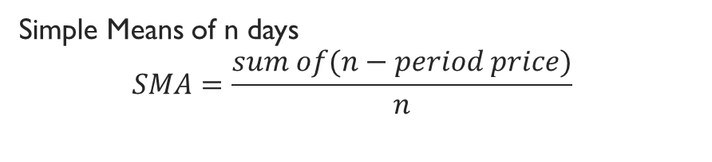
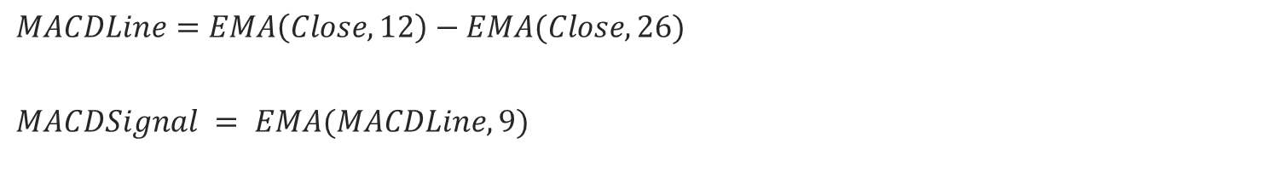
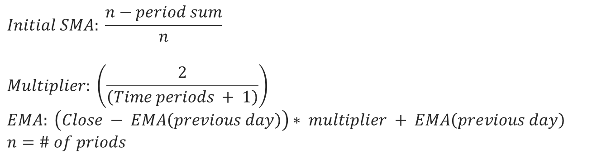
Simple Moving Average
Simple Means of n days
$$SMA=\frac{sum of(n−period price)}{n}$$
Exponential Moving Average
$$Initial SMA: \frac{n−period sum}{n}$$
$$Multiplier: \left(\frac{2}{\left(Time periods + 1\right)}\right)$$
$$EMA: \left(Close − EMA\left(previous day\right)\right)∗ multiplier + EMA\left(previous day\right)$$
$$n=\# of priods$$
Moving Average Convergence/Divergence (MACD)
$$MACDLine=EMA\left(Close,12\right)−EMA(Close,26)$$
$$MACDSignal = EMA(MACDLine,9)$$
Notes:
Trend analysis
MACD intersection of MACDline and signal
overlap
If current price is above the moving average values then the trend is ‘up’ and represented as ‘+1’, and if current price is below the moving average values then the trend is ‘down’ and represented as ‘1’.
MACD follows the trend of the stock, i.e. if MACD goes up then stock price also goes up and vice-a-versa. So, if the value of MACD at time ‘t’ is greater than the value at time ‘t1’, opinion on trend is ‘up’ and represented as ‘+1’ and if the value of MACD at time ‘t’ is less than value at time ‘t1’, opinion on trend is ‘down’ and represented as ‘1’.

Slide 9
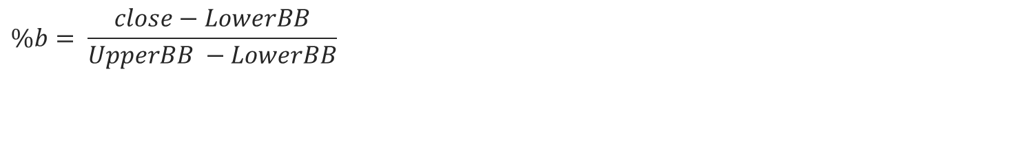
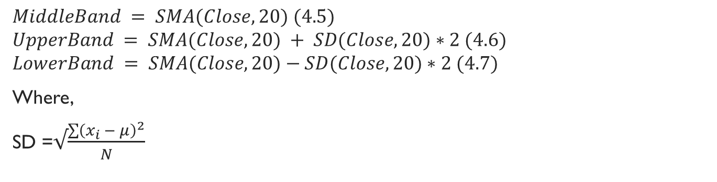
Triple Exponential Moving Average (TEMA)
$$TEMA=3∗EMA −3∗EMA\left(EMA\right)+EMA(EMA(EMA))$$
Bollinger Bands
$$MiddleBand = SMA(Close,20) (4.5)$$
$$UpperBand = SMA(Close,20) + SD(Close,20)∗2 (4.6)$$
$$LowerBand = SMA(Close,20)−SD(Close,20)∗2 (4.7)$$
Where,
SD =$√\frac{\sum{{\left(x_{i} − μ\right)}^{2}}}{N}$
%b
$$\%b= \frac{close−LowerBB}{UpperBB −LowerBB}$$
Notes:
TEMA is used in Trending market
W shape prediction

Slide 10
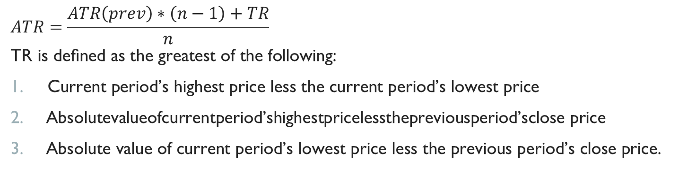
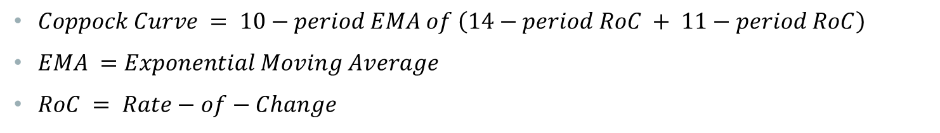
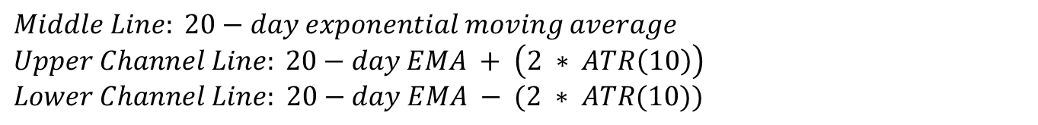
Average True Range (ATR) : measure of Volatility
$$ATR=\frac{ATR\left(prev\right)∗\left(n−1\right)+TR}{n}$$
$$\text{TR} \text{is} \text{de}\text{ﬁ}\text{ned} \text{as} \text{the} \text{greatest} \text{of} \text{the} \text{following}\text{: }$$
$\text{Current} \text{period}\text{’}\text{s} \text{highest} \text{price} \text{less} \text{the} \text{current} \text{period}\text{’}\text{s} \text{lowest} \text{price}$
$\text{Absolutevalueofcurrentperiod}\text{’}\text{shighestpricelessthepreviousperiod}\text{’}\text{sclose} \text{price}$
$\text{Absolute} \text{value} \text{of} \text{current} \text{period}\text{’}\text{s} \text{lowest} \text{price} \text{less} \text{the} \text{previous} \text{period}\text{’}\text{s} \text{close} \text{price}\text{.}$
Keltner Channels
$$Middle Line: 20−day exponential moving average$$
$$Upper Channel Line: 20−day EMA + \left(2 ∗ ATR\left(10\right)\right)$$
$$Lower Channel Line: 20−day EMA − (2 ∗ ATR(10))$$
Coppock Curve
$Coppock Curve = 10−period EMA of \left(14−period RoC + 11−period RoC\right)$
$EMA =Exponential Moving Average$
$RoC = Rate−of−Change$
Notes:
ATR measure the volitality low volitality –ve slop

Slide 11
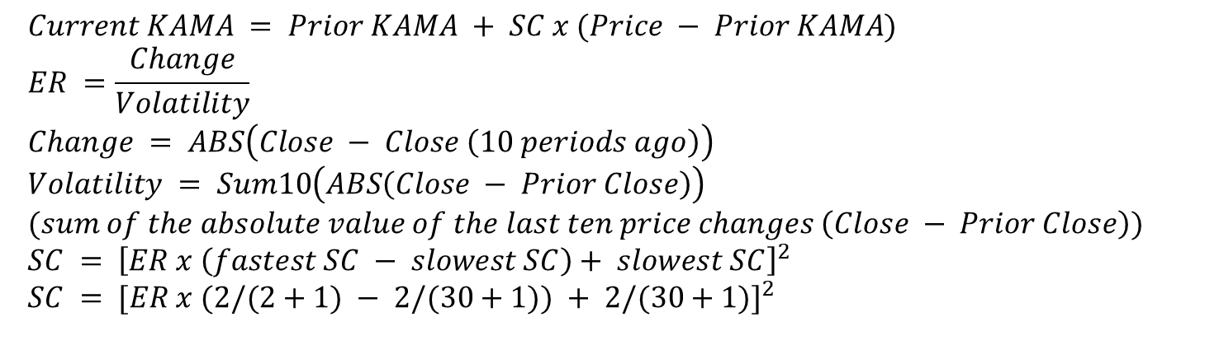
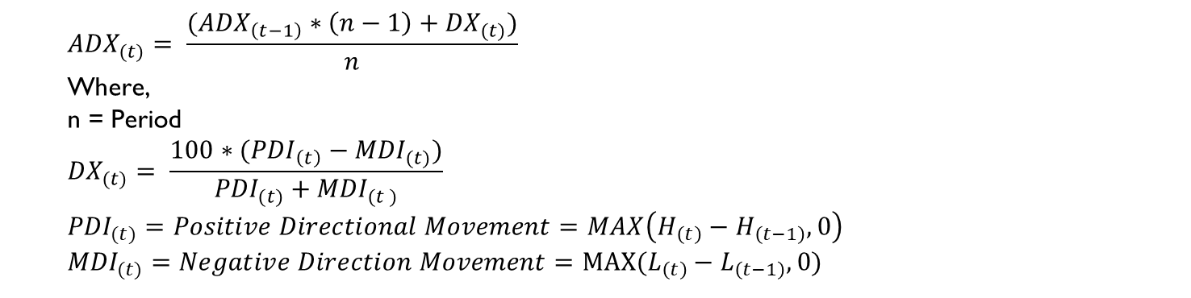
Kaufman's Adaptive Moving Average (KAMA)
$$Current KAMA = Prior KAMA + SC x (Price − Prior KAMA)$$
$$ER =\frac{Change}{Volatility}$$
$$Change = ABS\left(Close − Close \left(10 periods ago\right)\right)$$
$$Volatility = Sum10\left(ABS\left(Close − Prior Close\right)\right)$$
$$(sum of the absolute value of the last ten price changes \left(Close − Prior Close\right))$$
$$SC = {\left[ER x \left(fastest SC − slowest SC\right)+ slowest SC\right]}^{2}$$
$$SC = {[ER x (2/(2+1) − 2/(30+1)) + 2/(30+1)]}^{2}$$
Average Directional Index (ADX)
$${ADX}_{(t)}= \frac{({ADX}_{\left(t−1\right)}∗\left(n−1\right)+{DX}_{(t)})}{n}$$
$$\text{Where}\text{,}$$
$$\text{n}\text{ = }\text{Period}$$
$${DX}_{(t)}= \frac{100∗({PDI}_{\left(t\right)}−{MDI}_{(t)})}{{PDI}_{(t)}+{MDI}_{(t )}}$$
$${PDI}_{(t)}=Positive Directional Movement=MAX\left(H_{\left(t\right)}−H_{\left(t−1\right)},0\right)$$
$${MDI}_{(t)}=Negative Direction Movement=MAX(L_{\left(t\right)}−L_{\left(t−1\right)},0)$$
Notes:
ADX measures trend strength

Slide 12
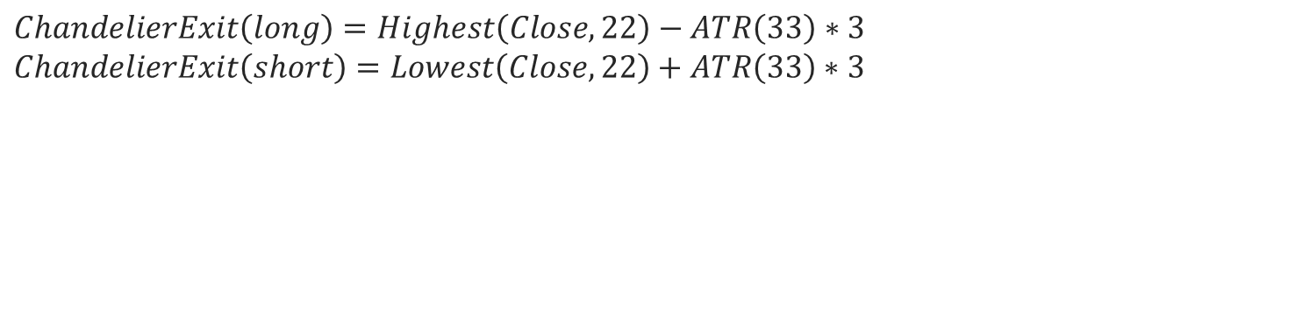
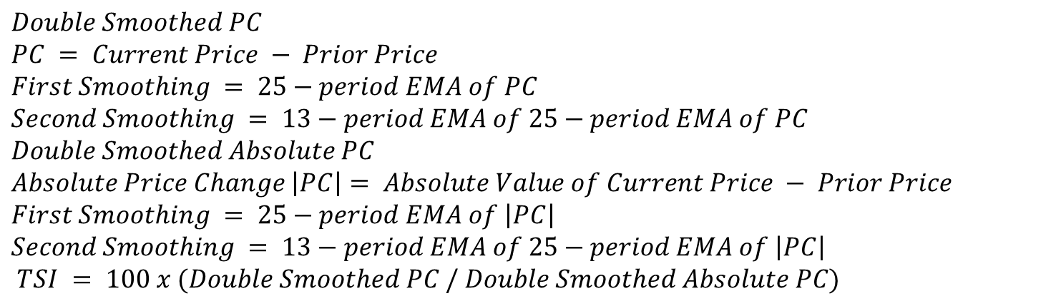
True Strength Index (TSI)
$$Double Smoothed PC$$
$$PC = Current Price − Prior Price$$
$$First Smoothing = 25−period EMA of PC$$
$$Second Smoothing = 13−period EMA of 25−period EMA of PC$$
$$Double Smoothed Absolute PC$$
$$Absolute Price Change \left|PC\right|= Absolute Value of Current Price − Prior Price$$
$$First Smoothing = 25−period EMA of \left|PC\right|$$
$$Second Smoothing = 13−period EMA of 25−period EMA of \left|PC\right|$$
$$TSI = 100 x (Double Smoothed PC / Double Smoothed Absolute PC)$$
Chandelier Exit
$$ChandelierExit\left(long\right)=Highest\left(Close,22\right)−ATR\left(33\right)∗3$$
$$ChandelierExit\left(short\right)=Lowest\left(Close,22\right)+ATR\left(33\right)∗3$$

Slide 13
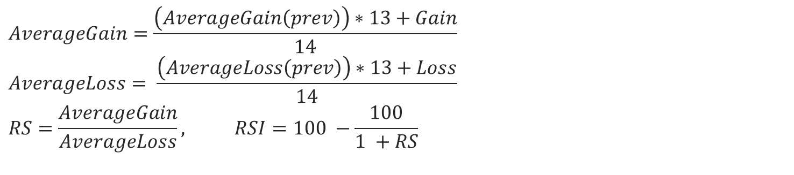
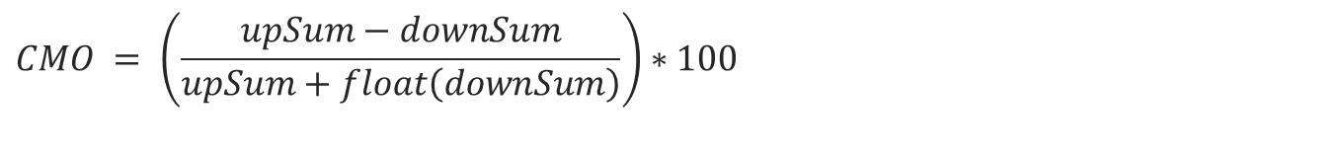
Rate Of Change(ROC)
$$ROC = \left[\frac{\left(Close − Close n periods ago\right)}{\left(Close n periods ago\right)}\right]x100$$
Chande Momentum Oscillator (CMO)
$$CMO = \left(\frac{upSum−downSum}{upSum+float\left(downSum\right)}\right)∗100$$
Relative Strength Index (RSI)
$$AverageGain=\frac{\left(AverageGain\left(prev\right)\right)∗13+Gain}{14}$$
$$AverageLoss= \frac{\left(AverageLoss\left(prev\right)\right)∗13+Loss}{14}$$
$$RS=\frac{AverageGain}{AverageLoss}, RSI=100 −\frac{100}{1 +RS}$$
Notes:
ROC simple momentum or pure momentum
Rsi oscillator between a given range
RSI is generally used for identifying the overbought and over-sold points. It ranges between 0 and 100. If the value of RSI exceeds 70 level, it means that the stock is overbought, so, it may go down in near future (indicating opinion ‘1’) and if the value of RSI goes below 30 level, it means that the stock is oversold, so, it may go up in near future (indicating opinion ‘+1’). For the values between (30, 70), if RSI at time ‘t’ is greater than RSI at time ‘t1’, the opinion on trend is represented as ‘+1’ and vice-a-versa

Slide 14
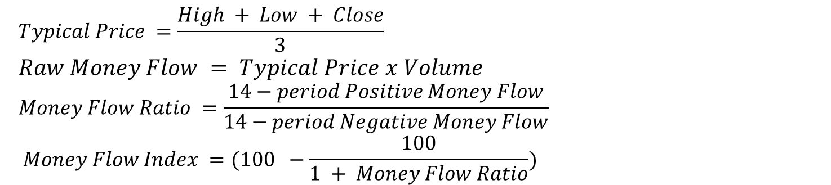
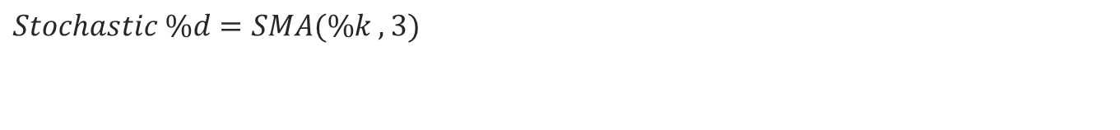
Stochastic %k (STCK)
$$Stochastic \%k= \frac{close −LL(p)}{HH\left(p\right)−LL(p)}∗100$$
Stochastic %D (STCD)
$$Stochastic \%d=SMA(\%k , 3)$$
Money Flow Index(MFI)
$$Typical Price =\frac{High + Low + Close}{3}$$
$$Raw Money Flow = Typical Price x Volume$$
$$Money Flow Ratio =\frac{14−period Positive Money Flow}{14−period Negative Money Flow}$$
$$Money Flow Index =(100 −\frac{100}{1 + Money Flow Ratio})$$
Notes:
When stochastic oscillators are increasing, the stock prices are likely to go up and vice-a-versa. This implies that if the value of stochastic oscillators at time ‘t’ is greater than the value at time ‘t1’ then the opinion of trend is ‘up’ and represented as ‘+1’ and vice-a-versa.

Slide 15
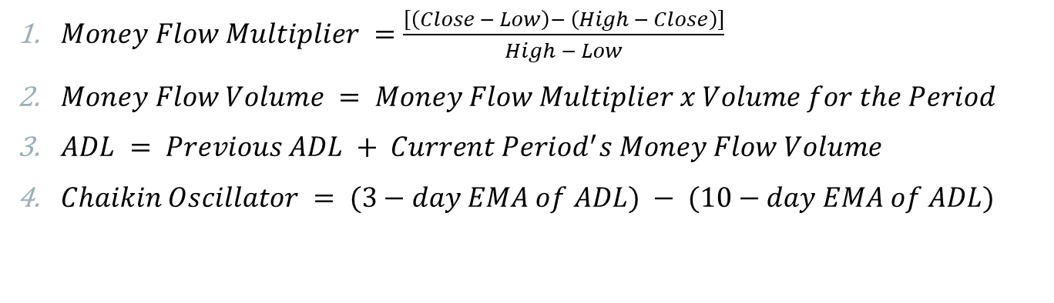
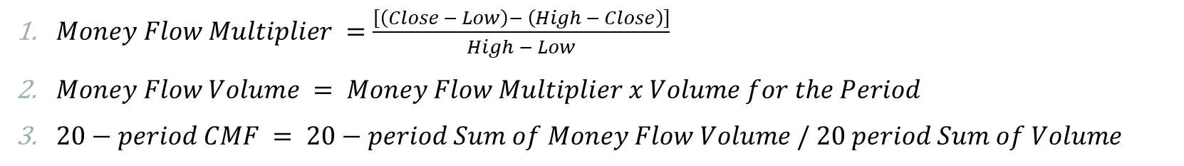
Chaikin Money Flow
$Money Flow Multiplier =\frac{\left[\left(Close − Low\right)− \left(High − Close\right)\right]}{High − Low}$
$Money Flow Volume = Money Flow Multiplier x Volume for the Period$
$20−period CMF = 20−period Sum of Money Flow Volume / 20 period Sum of Volume$
Chaikin Oscillator
$Money Flow Multiplier =\frac{\left[\left(Close − Low\right)− \left(High − Close\right)\right]}{High − Low}$
$Money Flow Volume = Money Flow Multiplier x Volume for the Period$
$ADL = Previous ADL + Current Period^{′}s Money Flow Volume$
$Chaikin Oscillator = (3−day EMA of ADL) − (10−day EMA of ADL)$

Slide 16
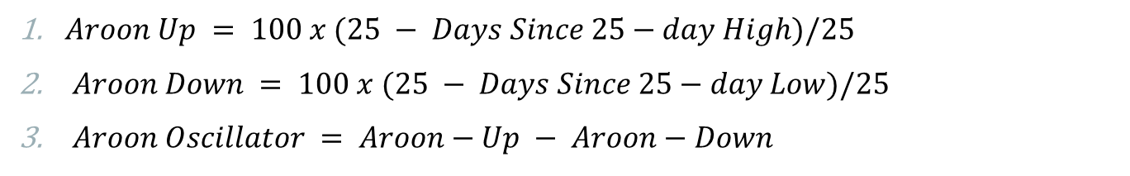
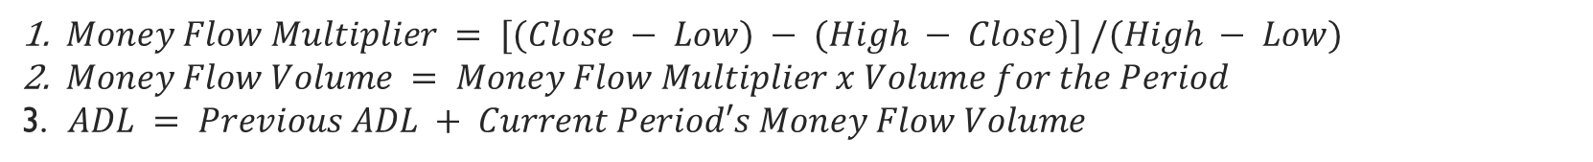
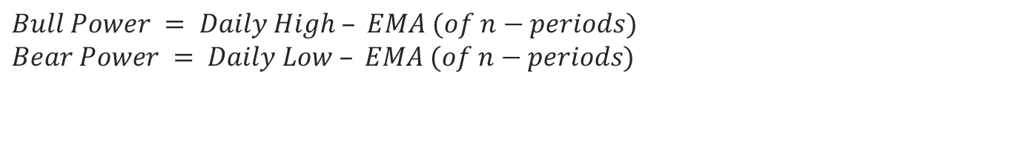
Accumulation Distribution Oscillation (ADO)
$Money Flow Multiplier = [(Close − Low) − (High − Close)] /(High − Low)$
$Money Flow Volume = Money Flow Multiplier x Volume for the Period$
$ADL = Previous ADL + Current Period′s Money Flow Volume$
Aroon Oscillator
$Aroon Up = 100 x (25 − Days Since 25−day High)/25$
$Aroon Down = 100 x (25 − Days Since 25−day Low)/25$
$Aroon Oscillator = Aroon−Up − Aroon−Down$
Elder-ray
$$Bull Power = Daily High – EMA (of n−periods)$$
$$Bear Power = Daily Low – EMA (of n−periods)$$

Slide 17
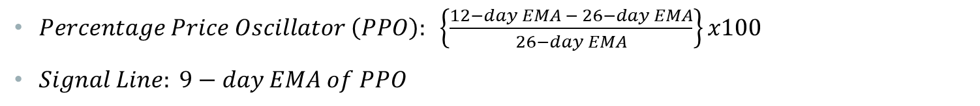
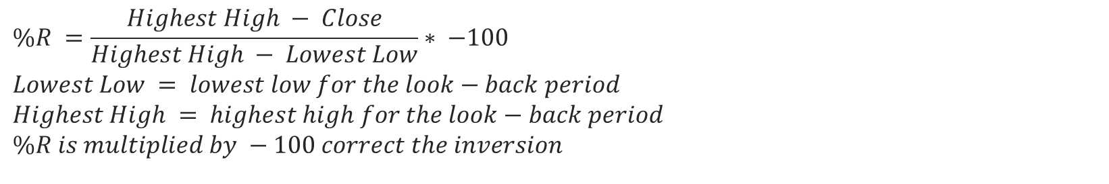
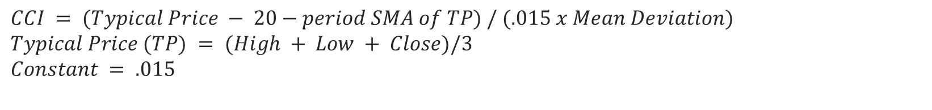
Percentage Price Oscillator
$Percentage Price Oscillator \left(PPO\right): \left\{\frac{12−day EMA − 26−day EMA}{26−day EMA}\right\}x100$
$Signal Line: 9−day EMA of PPO$
Commodity Channel Index (CCI)
$$CCI = (Typical Price − 20−period SMA of TP) / (.015 x Mean Deviation)$$
$$Typical Price (TP) = (High + Low + Close)/3$$
$$Constant = .015$$
Williams %R
$$\%R =\frac{Highest High − Close}{Highest High − Lowest Low}∗ −100$$
$$Lowest Low = lowest low for the look−back period$$
$$Highest High = highest high for the look−back period$$
$$\%R is multiplied by −100 correct the inversion$$
Notes:
Williams take the lowest low and highest high for n days and take percentage of every 0 - -100
CCI is also used for identifying over-bought and oversold levels. In this paper we have set 200 as over-bought level and 200 as oversold level as 200 is more representative of a true extreme . This means that if CCI value exceeds 200 level, the opinion for the trend is ‘1’ and if it is below 200 level then the opinion for the trend is ‘+1’. For the values between (200, 200), if CCI at time ‘t’ is greater than CCI at time ‘t1’, the opinion on the trend is ‘+1’ and vice-a-versa.

Slide 18
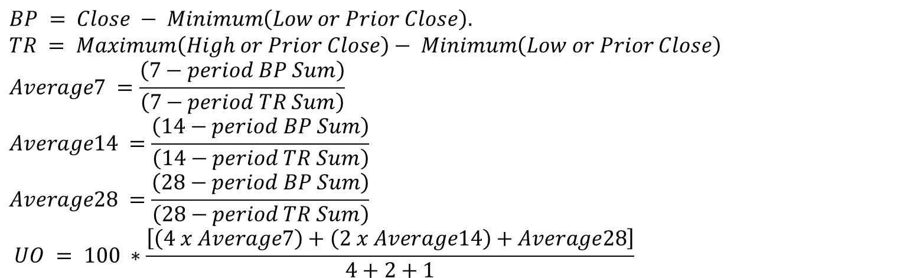
Ultimate Oscillator
$$BP = Close − Minimum\left(Low or Prior Close\right).$$
$$TR = Maximum\left(High or Prior Close\right)− Minimum\left(Low or Prior Close\right)$$
$$Average7 =\frac{\left(7−period BP Sum\right)}{\left(7−period TR Sum\right)}$$
$$Average14 =\frac{\left(14−period BP Sum\right)}{\left(14−period TR Sum\right)}$$
$$Average28 =\frac{\left(28−period BP Sum\right)}{\left(28−period TR Sum\right)}$$
$$UO = 100 ∗\frac{\left[\left(4 x Average7\right)+\left(2 x Average14\right)+Average28\right]}{4+2+1}$$

Slide 19
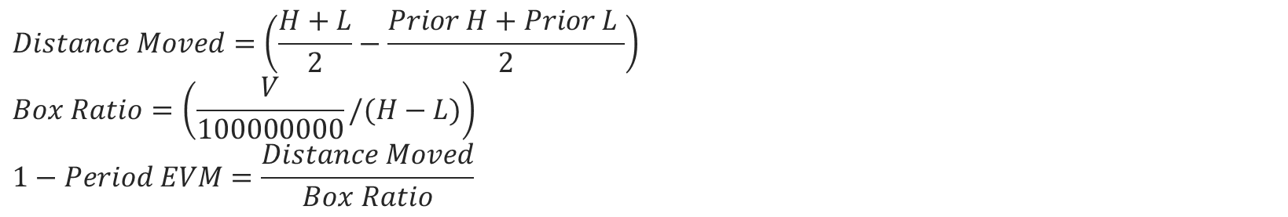
Force Index (FI)
$$Force Index = (Close (current period) − Close (prior period)) ∗ Volume$$
Ease of Movement EVM
$$Distance Moved=\left(\frac{H+L}{2}−\frac{Prior H+Prior L }{2}\right)$$
$$Box Ratio=\left(\frac{V}{100000000}/(H−L)\right)$$
$$1−Period EVM=\frac{Distance Moved}{Box Ratio}$$
Notes:
Fi depends on volume and price
Evm is volume based oscillator 14 day = 14 da

Slide 20
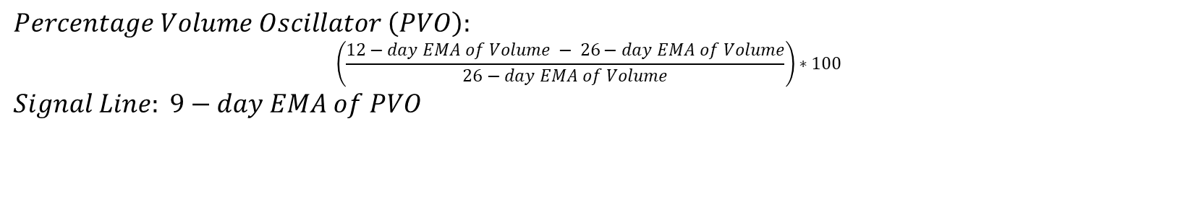
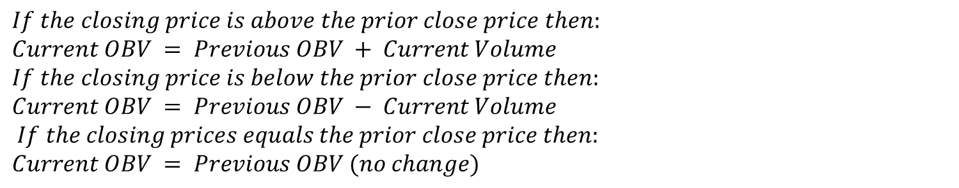
On Balance Volume (OBV)
$$If the closing price is above the prior close price then:$$
$$Current OBV = Previous OBV + Current Volume$$
$$If the closing price is below the prior close price then:$$
$$Current OBV = Previous OBV − Current Volume$$
$$If the closing prices equals the prior close price then:$$
$$Current OBV = Previous OBV (no change)$$
Percentage Volume Oscillator(PVO)
$$Percentage Volume Oscillator \left(PVO\right):$$
$$\left(\frac{12−day EMA of Volume − 26−day EMA of Volume}{26−day EMA of Volume}\right)∗100$$
$$Signal Line: 9−day EMA of PVO$$

Slide 21
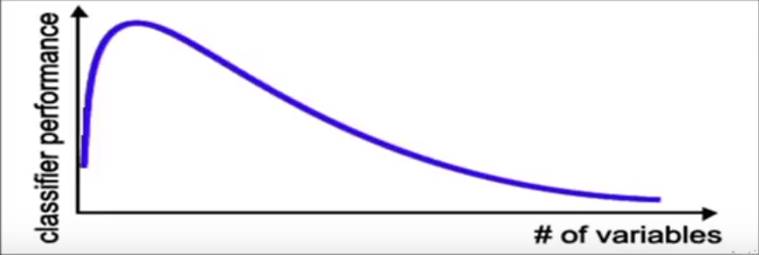
Feature Reduction (Curse of Dimensionality)
Notes:
More feature means more information and better classification power which is not true
Having irrelevant features introduces noise
Having Redundant features can confuse over model and increases computational rate
Either improve or maintain model accuracy and simplify the classifier complexity
2^n possible subset features
Select uncorrelated features

Slide 22
Correlation
It means a relation between 2 or more things
It is a statistical technique which helps us to find what kind of relation exist between 2 or more features or data

Slide 23
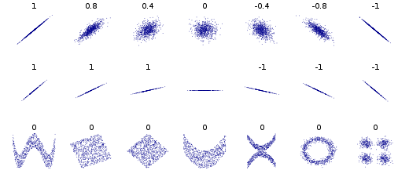
Scatter Diagram

Slide 24
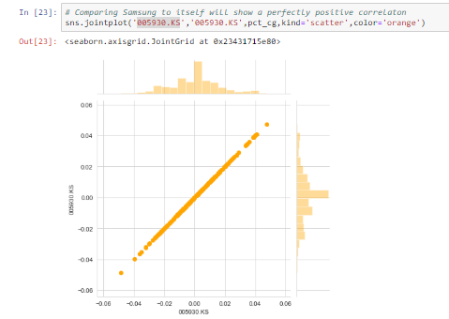
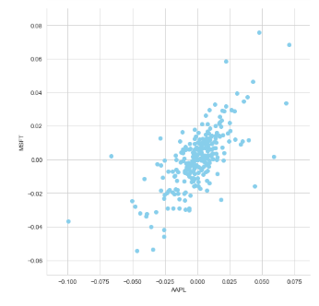

Slide 25
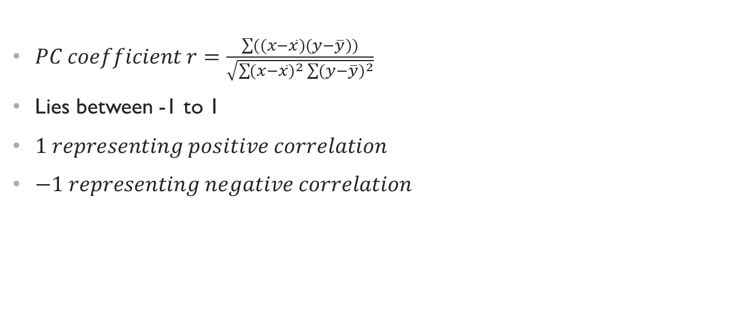
Pearson Correlation
$PC coefficient r=\frac{\sum{((x−\overline{x})(y−\overline{y}))}}{\sqrt{\sum{{(x−\overline{x})}^{2}}\sum{{(y−\overline{y})}^{2}}}}$
Lies between -1 to 1
$1 representing positive correlation$
$−1 representing negative correlation$
Notes:
product moment or simple correlation

Slide 26
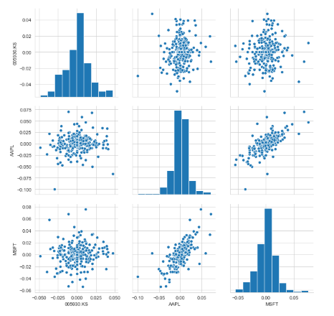
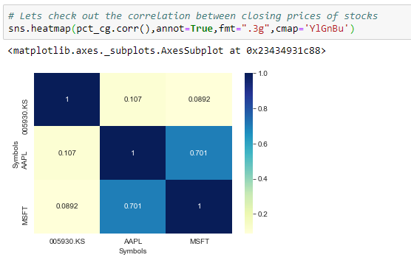

Slide 27
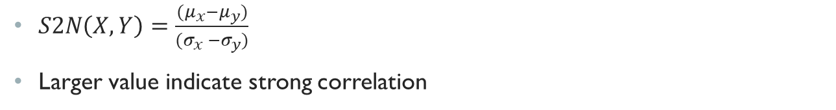
Signal to noise ratio
$S2N\left(X,Y\right)=\frac{(μ_{x}−μ_{y})}{(σ_{x} −σ_{y})}$
Larger value indicate strong correlation

Slide 28
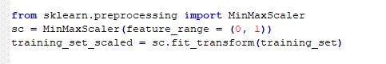
DATA transformation
Why data transform?
To normalize the data
Helps make the data stationary

Slide 29
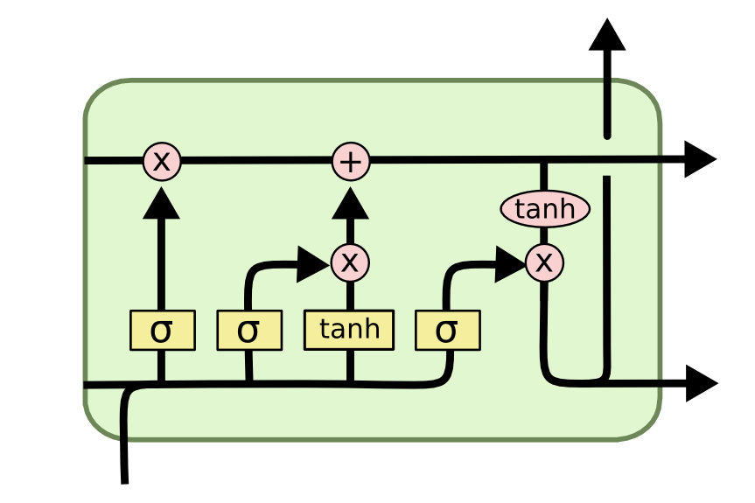
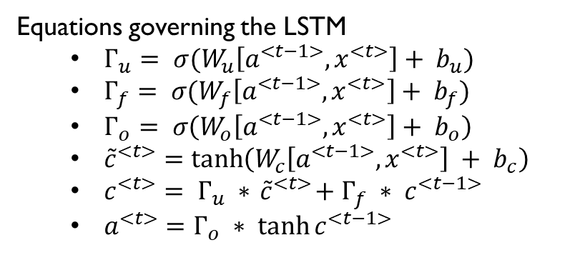
LSTM
Consists of 3 gates
Update gate
Forget gate
Output gate
Equations governing the LSTM
$Г_{u}= σ(W_{u}\left[a^{<t−1>},x^{<t>}\right]+ b_{u})$
$Г_{f}= σ(W_{f}\left[a^{<t−1>},x^{<t>}\right]+ b_{f})$
$Г_{o}= σ\left(W_{o}\left[a^{<t−1>},x^{<t>}\right]+ b_{o}\right)$
${\tilde{c}}^{<t>}=\tanh\left(W_{c}\left[a^{<t−1>},x^{<t>}\right] + b_{c}\right)$
$c^{<t>}= Г_{u} ∗{ \tilde{c}}^{<t>}+ Г_{f} ∗ c^{<t−1>}$
$a^{<t>}=Г_{o} ∗ \tanh{c^{<t−1>}}$

Slide 30
advantages
Neural Networks have the ability to learn and model non-linear and complex relationships.
Neural Networks can learn hidden relationship from input dataset that are heteroscedasticity i.e. data with high volatility and non-constant variance.
Robust
Gets better over time

Slide 31
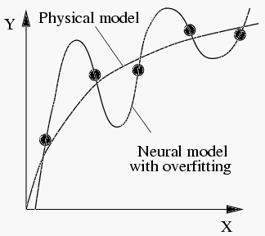
Disadvantages
Black Box Property
Overfitting
Training takes a lot of time, Computationally Expensive

Slide 32
Prediction
Moment of truth

Slide 33
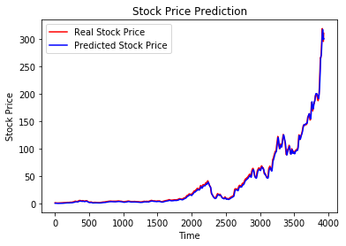
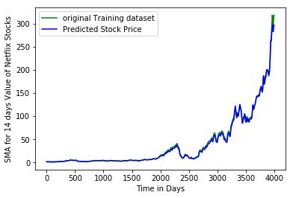
Prediction for train dataset
Sliding Window Approach
Without Sliding window

Slide 34
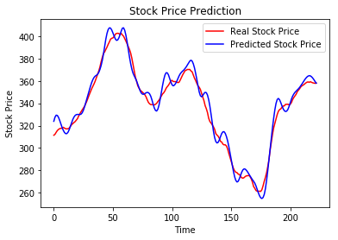
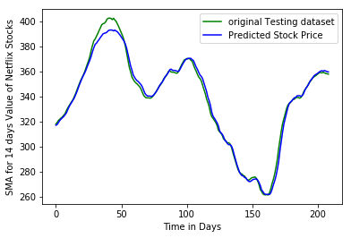
Prediction for Test dataset
Sliding Window Approach
Without Sliding window

Slide 35
Result Analysis
Sliding Window Approach
Without Sliding window
Input | RMSE | Size
Train | 2.5983 | 3934
Test | 6.3923 | 223
Input | RMSE | Size
Train | 2.8778 | 3994
Test | 3.5498 | 211

Slide 36
Risk Analysis
Value at Risk
Notes:
Let's go ahead and define a value at risk parameter for our stocks. We can treat value at risk as the amount of money we could expect to lose (aka putting at risk) for a given confidence interval.

Slide 37
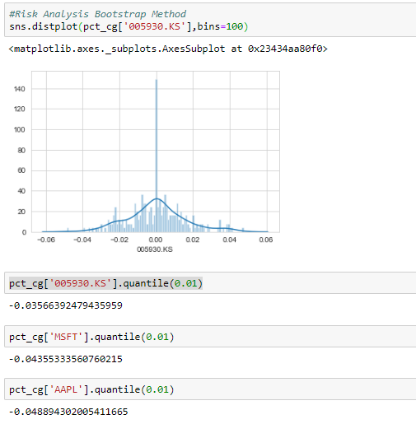
Bootstrap method
Notes:
The 0.05 empirical quantile of daily returns is at -0.016. That means that with 95% confidence, our worst daily loss will not exceed 1.6%. If we have a 1 million dollar investment, our one-day 5% VaR is 0.016 * 1,000,000 = $16,000.

Slide 38
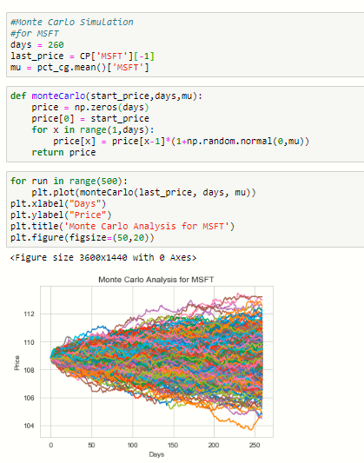
Monte Carlo Method

Slide 39
References
Image : https://upload.wikimedia.org/wikipedia/commons/thumb/d/d4/Correlation_examples2.svg/400px-Correlation_examples2.svg.png
Book:
P. G. Mulloy. Smoothing data with less lag. Technical Analysis of Stocks and Commodities
G. Appel. Technical Analysis: Power Tools for Active Investors. Financial Times Prentice Hall, 2005.
Also https://stockcharts.com/, https://in.finance.yahoo.com/, http://colah.github.io/posts/2015-08-Understanding-LSTMs/, http://en.wikipedia.org/wiki/Quantile/

Slide 40
Thank You

